Slide 1
IO2 – Induction to Pedagogy for NGO staff
Module 1 – Understanding the Non-Governmental Organisations
Prepared by UPB
ERASMUS+ Programme – Strategic Partnership
Agreement No.
2018-1-DE02-KA204-005014
This project has been funded with the support from the European Commission. This publication reflects the views only of the author, and the Commission cannot be held responsible for any use which may be made of the information contained therein.

Slide 2
Agenda
1. What is does NGO mean?
1.1 Megatrends and driving forces
1.2 Drivers of ecological thinking in NGOs
1.3 Characteristics of green NGOs
2. What are their specifics?
2.1 Legal forms of NGOs (European Comparison)
2.2 Technology and technical issues in NGOs
3. What are they doing?
3.1 Benefits of the NGOs

Slide 3
Learning Outcomes of Module 1
Understand the characteristics and specifics of the green NGOs
Understand the driving forces and structures within the NGOs
Understand how the current business environment may impact on NGOs
Source: Roman Synkevych, https://unsplash.com/photos/B4Ngz_pdvz4

Slide 4
Overview on Module 1: Understanding the Non-Governmental Organisations
Module/Unit | Learning Outcomes – The learner will: | Indicative Content
Understanding the Non-Governmental Organisations | Understand the driving forces and structures within the NGOs Understand how the current business environment may impact on NGOs Understand the characteristics of the green NGOs | Megatrends and driving forces Drivers of ecological thinking in NGOs Technology and technical issues in NGOs Benefits of the NGOs Structures of NGOs

Slide 5
1. What does NGO mean?- Definition
“A non-governmental organization (NGO) is a non-for-profit, voluntary citizens’ group, which is organized on a local, national or international level to address issues in support of the public good.” (United Nations)
This project has been funded with the support from the European Commission. This publication reflects the views only of the author, and the Commission cannot be held responsible for any use which may be made of the information contained therein.

Slide 6
Task / Exercise

Slide 7
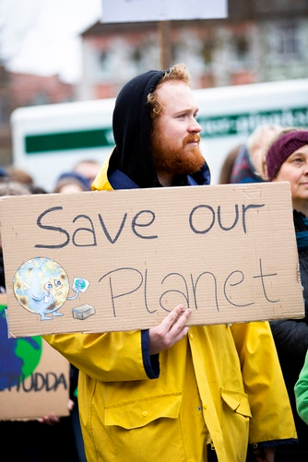
1.1 Megatrends and driving forces
Globalisation
Environmental and climate threats
Global increasing migration
(European Commission 2019)
Source: Markus Spiske, https://unsplash.com/photos/E7p54JSQXY0

Slide 8
Have a look at the following video.
After watching write down the most important aspects about the integration of blended learning and how this can work! Share your ideas with the group.
Task

Slide 9
NGO
Video 1: What is an NGO (non governmental organization)? https://www.youtube.com/watch?v=PCxJ1Ug0v6s
Kestrel Creative – YouTube Standard Licence
Video 2: What is an NGO? https://www.youtube.com/watch?v=D4dC0gxFkDs
Mohit Shetty - YouTube Standard Licence
Task

Slide 10
Thank you very much for
your attention!
Prepared by UPB
ERASMUS+ Programme – Strategic Partnership
Agreement No.
2018-1-DE02-KA204-005014
Websites: http://www.ngenvironment-project.eu/ http://ngenvironment.eduproject.eu/
This project has been funded with the support from the European Commission. This publication reflects the views only of the author, and the Commission cannot be held responsible for any use which may be made of the information contained therein.

Slide 11
Sources
eAdvocates for International Development (2017): EU registration options for NGOs - Preparing UK-based NGOs for Brexit: A guide to establishing NGOs in Europe. Availbale under http://www.a4id.org/wp-content/uploads/2017/02/EU-registration-options-for-UK-NGOs-post-Brexit-FINAL-PDF-1.pdf.
BMZ (2019): Nichtregierungsorganisationen (Private Träger und Sozialstrukturträger). Available under https://www.bmz.de/de/ministerium/wege/bilaterale_ez/akteure_ez/nros/indx.html.

