Slide 1
NGEnvironment
NGEnvironment 5th Partner Meeting via ZOOM The NGEnvironment Survival Guide and Policy Paper Conference
23rd- 25th of March 2021
Project Number: 2018-1-DE02-KA204-005014
Foster European Active Citizenship and Sustainability Through Ecological Thinking by NGOs
A warm welcome to the NGEnvironment
Project partners
The European Commission support for the production of this publication does not constitute an endorsement of the contents which reflects the views only of the authors,
and the Commission cannot be held responsible for any use which may be made of the information contained therein.

Slide 2
Welcome to our Online Meeting!
The NGEnvironment Survival Guide and Policy Paper Conference
NGEnvironment 5th Partner Meeting via ZOOM 23rd- 25th of March 2021
Project Number: 2018-1-DE02-KA204-005014

Slide 3
Meeting - Venue:
ZOOM instead of
Across Limits Ltd. (AL)
Hilltop Gardens,
Triq L-Inkwina,
Naxxar, NXR2641
Malta

Slide 4
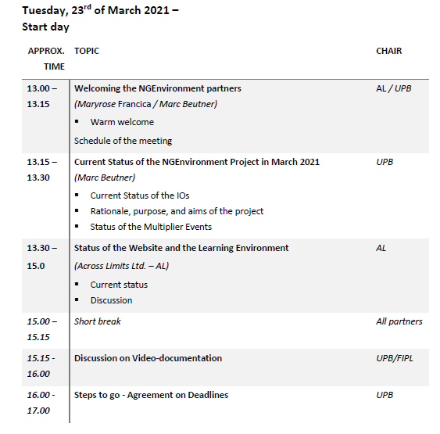
Tuesday, 23rd of March 2021 Start day

Slide 5
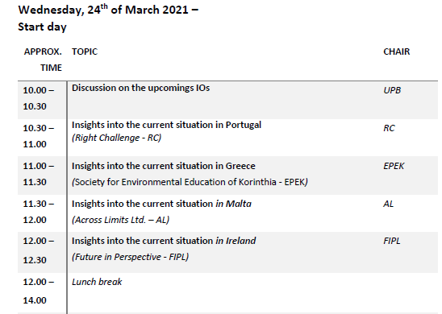
Wednesday, 24th of March 2021 Second workshop day!

Slide 6
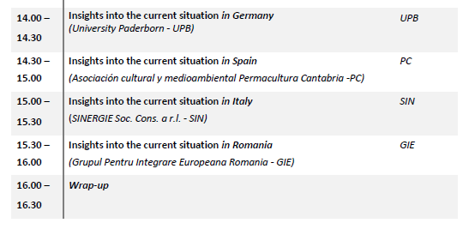
Wednesday, 24th of March 2021 Second workshop day!

Slide 7
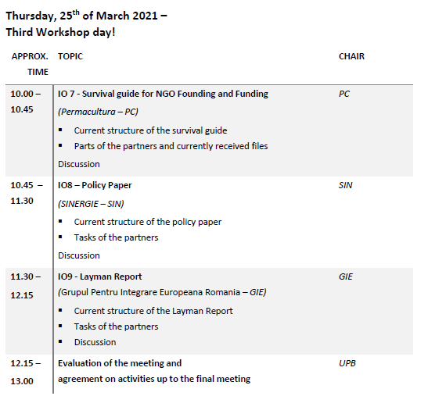
Thursday, 25th of March 2021– Third Workshop day!

Slide 8
Contact
Marc Beutner University Paderborn, Warburger Str. 100 33098 Paderborn, Germany Marc.Beutner@uni-paderborn.de
http://wiwi.uni-paderborn.de/department5/ wirtschaftspaedagogik-prof-beutner/
The European Commission support for the production of this publication does not constitute an endorsement of the contents which reflects the views only of the authors,
and the Commission cannot be held responsible for any use which may be made of the information contained therein.

