Slide 1
NGEnvironment
NGEnvironment 5th Partner Meeting via ZOOM The NGEnvironment Survival Guide and Policy Paper Conference
23rd- 25th of March 2021
Project Number: 2018-1-DE02-KA204-005014
Foster European Active Citizenship and Sustainability Through Ecological Thinking by NGOs
Current Status
The European Commission support for the production of this publication does not constitute an endorsement of the contents which reflects the views only of the authors,
and the Commission cannot be held responsible for any use which may be made of the information contained therein.

Slide 2
Welcome to our Online Meeting!
The NGEnvironment Survival Guide and Policy Paper Conference
NGEnvironment 5th Partner Meeting via ZOOM 23rd- 25th of March 2021
Project Number: 2018-1-DE02-KA204-005014

Slide 3
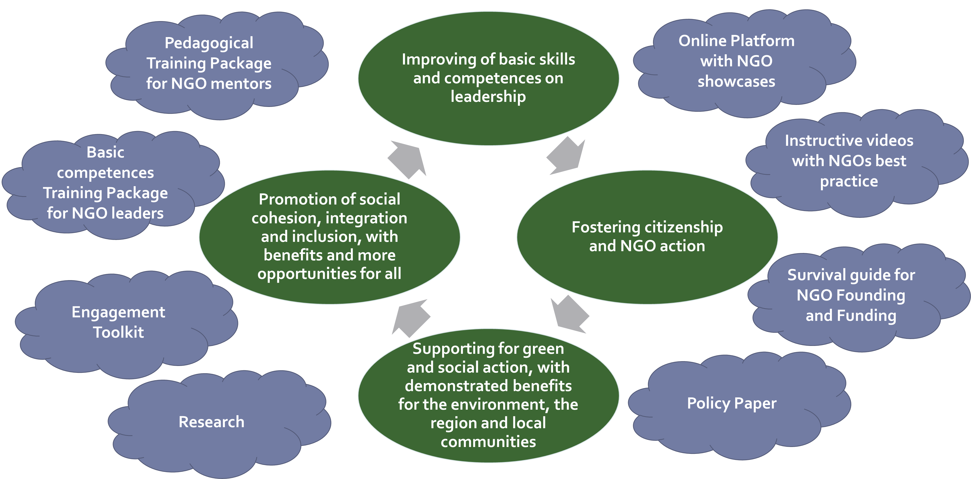
Core Aspects of NGEnvironment

Slide 4
INTELLECTUAL OUTPUTS
1
✓
Summary research report
Induction to Pedagogy for NGO staff
Training package for social and green NGO leadership
Online platform and Observatory
Engagement toolkit
Audiovisual instructive package
Survival guide for NGO Founding and Funding
Policy paper
Layman report
Not financed – We created definitions on NGOs
✓
✓
Finalising testing and evaluation
research report
2
3
✓
✓
Finalising testing and evaluation
research report
✓
✓
4
Not financed – Some observatory interviews
are missing
5
✓
6
✓
✓
3 videos throughout
the project lifecycle
Ongoing
7
Ongoing
8
Coming soon
9
Coming soon

Slide 5
IO1 - Summary research report
Not financed – We created definitions on NGOs.
Germany
Malta
Portugal
Romania
Spain
Ireland
Italy
✓

Slide 6
IO2 - Induction to Pedagogy for NGO staff
IO2-modules | Lesson Plan | Presentations | Videos | H5P tasks
Module 1 - UPB
Module 2 – UPB
Module 3 – EPEK
Module 4 – EPEK/AL
Module 5 – RC
✓
✓
✓
✓
✓
✓
✓
✓
✓
✓
✓
✓
✓
✓
✓
✓
✓
✓
✓
✓

Slide 7
IO2 - Induction to Pedagogy for NGO staff
Translation of the modules, lesson plans, presentations, videos and H5P task are done by all partner institutions
Finalising the pedagogy training in each country with n=10 (future) NGO leaders
Evaluation of the Induction to Pedagogy for NGO staff training in the partner countries
Evaluation Research Report
Germany
Malta
Portugal
Romania
Spain
Ireland
Italy
✓
✓
Evaluation Research Report is missing
✓
✓
✓
✓
✓

Slide 8
IO3 - Training package for social and green NGO leadership
IO3-modules | Lesson Plan | Presentations | Videos | H5P tasks
Module 1 - UPB
Module 2 – EPEK
Module 3 – EPEK
Module 4 – UPB
Module 5 – UPB
Module 6 – RC
Module 7 – RC
✓
✓
✓
✓
✓
✓
✓
✓
✓
✓
✓
✓
✓
✓
✓
✓
✓
✓
✓
✓
✓
✓
✓
✓
✓
✓
✓
✓

Slide 9
IO3 - Training package for social and green NGO leadership
Translation of modules, lesson plans, presentations, videos and H5P task are done by all partner institutions
Finalising the testing/running of the IO3 training package in the partner countries with n=20 participants
Evaluation of the training package in the partner countries → Evaluation Research Report
✓
Germany
Malta
Portugal
Romania
Spain
Ireland
Italy
✓
Evaluation Research Report is missing
✓
✓
✓
✓
✓

Slide 10
IO4 - Online platform and observatory
To present role models for NGO leadership;
To provide instant access to a library of information resources;
To provide a range of on-line environments and forums where NGO leaders/staff members can exchange ideas and practices with their peers in partner countries, collaborate on potential joint ventures and support each other;
To demonstrate the powerful impact that civic action may present in contributing locally or regionally for solving major environmental issues, while at the same time alleviating social issues;
The observatory will feed powerful evidence-based content for the Policy Paper (IO8).

Slide 11
IO4 - Online platform and observatory
Not financed – We decided to describe 1 NGO per country.
Structure
Germany
Malta
Portugal
Romania
Spain
Ireland
Italy
✓
✓
✓
✓
✓
✓
✓
✓

Slide 12
IO5 - Engagement toolkit
This output will then be a comprehensive engagement toolkit that will mostly support and inform field work to engage potential new NGO leaders to take part of the immersion programme and the training course; existing NGO leaders and staff members to enlist to the project’s online platform and observatory and to be willing to host the immersion programme.
The engagement toolkit will comprise a variety of means specifically tailored to different and very specific audiences identified during the research phase, and may include short videos (for portable devices), specific brochures, booklets or leaflets, scrapbooks and photographs, info graphics, audiovisual testimonials, among others; being different in approach, design and contents from the products generated for the general dissemination of the project.

Slide 13
IO5 - Engagement toolkit
Germany
Malta
Portugal
Romania
Spain
Ireland
Italy
✓
✓
✓
✓
✓
✓
✓

Slide 14
IO6 - Audiovisual package
To complement the Induction to Pedagogy for NGO staff, the NGO immersion program and the training course a set of 5 audiovisual products will be developed, mainly in the form of 3 minutes videos and animations. Additionally, a set of 3 videos will be created throughout the project lifecycle.
Video structure created and decided
Germany
Malta
Portugal
Romania
Spain
Ireland
Italy
✓
✓
✓
✓
✓
✓
✓

Slide 15
IO6 - Audiovisual package
5 audiovisual products structure developed and decided
State of the translations
Germany
Malta
Portugal
Romania
Spain
Ireland
Italy
a set of 3 videos will be created throughout the project lifecycle
✓
✓
✓
✓
✓
✓

Slide 16
IO7 - Survival guide for NGO Founding and Funding
PC presents its research framework
Research: February 2021 until end of March 2021 (ongoing)
Creation of Survival Research report for each partner country (ongoing)
PC will collate information: June 2021 (coming soon)
PC will create a final Survival guide Research report (coming soon)
All Partners translation: June-August 2021 (coming soon)
✓

Slide 17
Financial Report material is missing
UPB created a table with the financial status for every partner institution
Some materials are missing as:
(Zero)-Timesheets !!! Please create your Timesheets in PROM !!
Signature on the Travel Cost records
Evidences of the travels as invoices etc.
Employee contracts
VAT-Declarations etc.

Slide 18
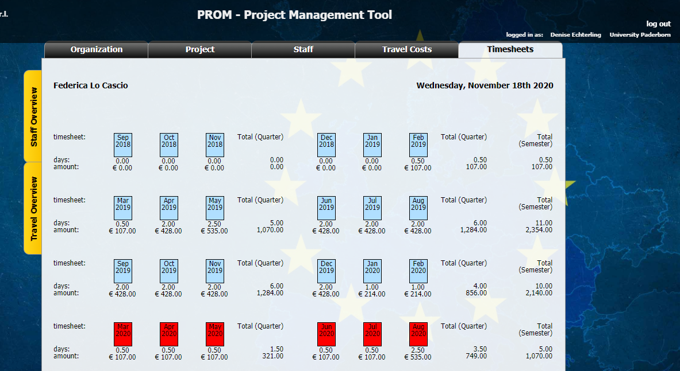
Financial Report material is missing

Slide 19
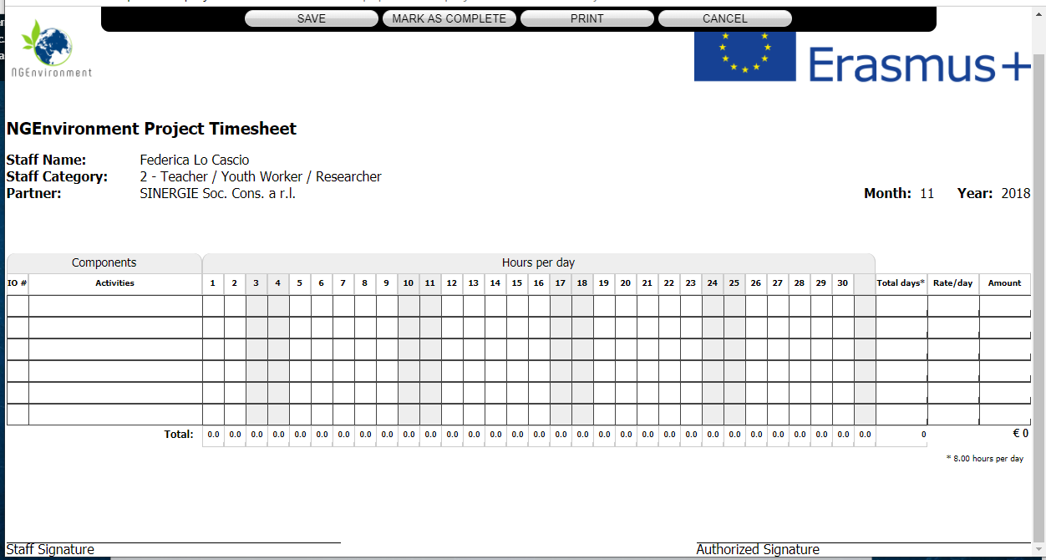
Financial Report material is missing

Slide 20
Multiplier Events
Deadline: July 2021
N= 30 persons
Presenting all IOs and results of the project
Online Multiplier Event is possible (Confirmation by NA)
With regard to the organisation and finances, the following applies:
(a) Calculation of the grant amount: The grant amount is calculated by multiplying the number of participants not belonging to the beneficiary, not belonging to an associated partner and not belonging to a partner organisation involved in the project by 15% of the financial contribution as defined in Annex IV of the Agreement. There is a maximum amount of EUR 5,000 per project.

Slide 21
Multiplier Events
(b) Trigger event: Entitlement to the grant amount arises from the fact that the multiplier event has taken place and is of an acceptable quality level.
(c) Evidence:
a . Evidence of the multiplier event carried out virtually, stating the title and date of the event.
b. Evidence of the number of participants by a declaration signed by the organiser stating the names of the participants and the name and address of the sending organisation or institution.
c. Documents used or distributed at the multiplier event.

Slide 22
General aspects
Declaration of Attendance of M4 / M5
Original documents via post
Scanned documents
Participation lists of Steering Committees
send by post to all partners to receive original signatures
Status? Who has the list at the moment?

Slide 23
Contact
Marc Beutner University Paderborn, Warburger Str. 100 33098 Paderborn, Germany Marc.Beutner@uni-paderborn.de
http://wiwi.uni-paderborn.de/department5/ wirtschaftspaedagogik-prof-beutner/
The European Commission support for the production of this publication does not constitute an endorsement of the contents which reflects the views only of the authors,
and the Commission cannot be held responsible for any use which may be made of the information contained therein.

