Slide 1
Who is a climate leader?
TESTIMONIALS FROM ITALY

Slide 2
We have only 11 years to save our species.
The planet is burning!
From the Fridays for Future Italia website
www.fridaysforfutureitalia.it

Slide 3
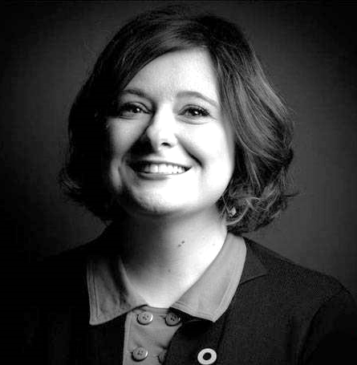
Claudia Laricchia Italian «Climate Leader»
She is:
Head of the Institutional Relations and Global Strategic Partnership of the Future Food Institute
Climate Leader of the Climate Reality Project of Al Gore
President of the Commission for the Environment and Innovation of the Italian Federation of Human Rights
ITA
«Non sappiamo quanto tempo ci resta prima di raggiungere il punto di non ritorno. Dipende da ciascuno di noi e dalla cura e gentilezza che mettiamo in ogni istante della nostra vita sul Pianeta».
ENG
"We don't know how much time we have left before we reach the point of no return. It depends on each of us and on the care and kindness we put into every moment of our life on the Planet».
Read the full article at this link: http://www.vita.it/it/article/2019/10/03/ma-cosa-fa-una-climate-leader/152840/

